Slide 1

COVID-19 Vaccine analysis
Presenters: David, Evann, Grace, & Shannon

Slide 2
Introduction & Management Approach
Analyze the Covid-19 pandemic – Comparing Infection vs Vaccine Rollout
Used Agile development method for Brainstorming in Agile teams. During the brainstorming session, all participants were invited to express as many options as possible to analyze the data
Assessed the United States in terms of the spread of the contagion by state, hospitalization rate, death rate, increase in death rate over time, vaccinations, vaccination trends, and conclusions drawn from vaccine rollout
From the data we can see trends and draw conclusions of societal norms based on age, sex and geographic location, what legislative best practices worked, and draw conclusion about vaccines

Slide 3
Data Cleansing and Analysis
Data extraction and Cleansing
Transformation of Data
Python, postgres, flask, D.3
Notes:
This is the process that we utilized to produce our output.
Prepare a 10-minute presentation that lays out your theme, coding approach, data munging techniques, and final visualization
Connected PostGres to Flask to and Flask to JS – The JS is actually what goes through to the HTML file.
We used Plotly, Cloropleth Maps, and JavaScript to create graphical figures and interactive dashboards with D.3

Slide 4
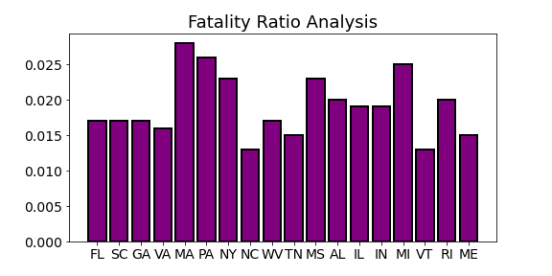
Notes:
The fatality ratio for the East coast. Places like Vermont, New Hampshire, Delaware, and Maine where the population is vastly different from NJ and NY the fatality ratio is very good in comparison to their east coast bredren NY, PA, CT, NJ.

Slide 5
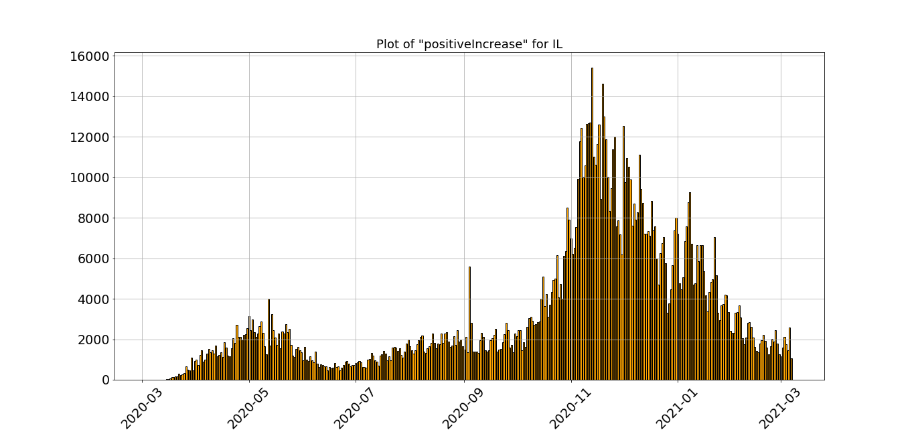
Hospitalization Rate Leading Into Vaccine Rollout
Notes:
Positive increase for NY – You can see throughout the summer and into November NY made great strides against the virus.
A sudden peek came about when the holiday season hit and the new year began. Its almost like were going backwards in NY

Slide 6
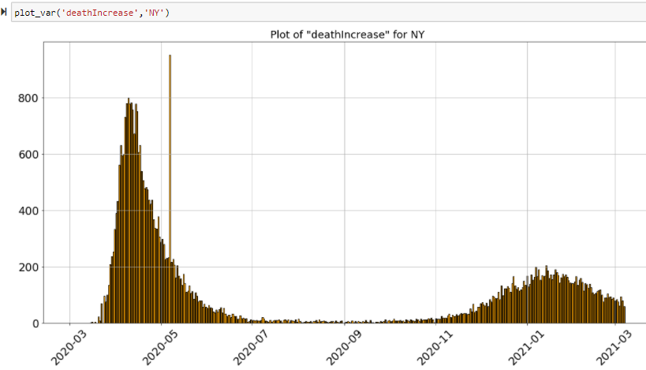
Death Rate Leading Into Vaccine Rollout
Notes:
The death increase in NY is not as alarming as the rise in cases. In comparison to last year the death rate is expected to be dismal in comparison to last April vs. this April.

Slide 7
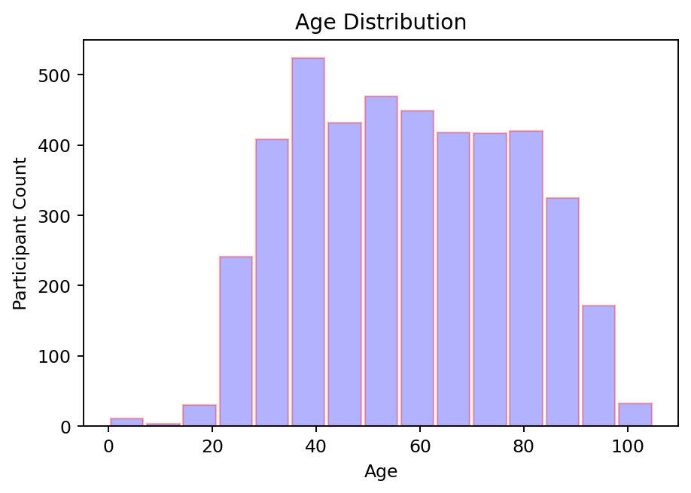
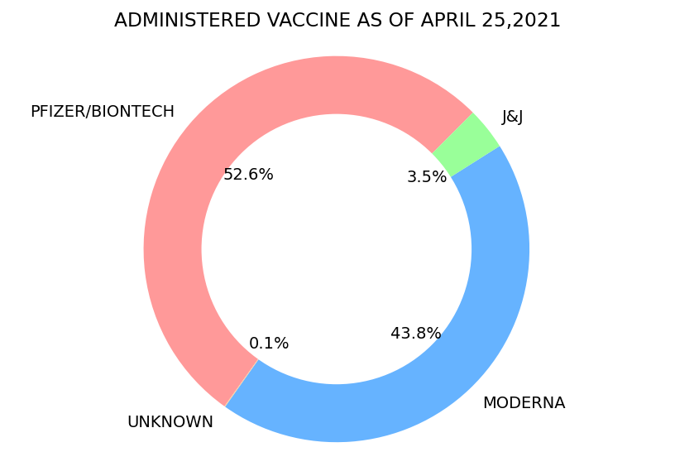
Age Distribution & Vaccine Rollout
Notes:
West coast = High Covid Fatality

Slide 8
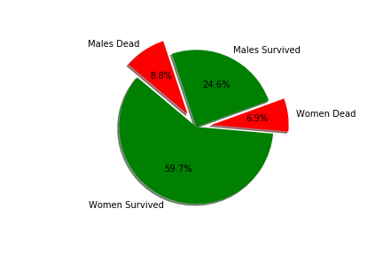
Vaccine Mortality Rates in U.S.
Notes:
We wanted to compare some of the more known states and larger metro areas. In terms of fatality, it is estimated that the contagion rate and marketing of vaccine rollout in various states impacted number of individuals Vaccinated. Which subsequently drove the mortality rates.

Slide 9
Summary
COVID-19 has taken a great number of lives
Social distancing and systematic combative approaches to follow best practices, are helping to reduce the spread of cases
Vaccine Rollout
Enjoy the Presentation ☺

